Slide 1
IPL ANALYSIS
Analysis by: Zoher Behrainwala

Slide 2
INTRODUCTION
The Indian Premier League (IPL) is a professional Twenty20 cricket league, contested by 8 teams based out of couple of Indian cities.
The league was founded by the Board of Control for Cricket in India (BCCI) in 2007.
It is usually held between March and May of every year and has an exclusive window in the ICC Future Tours Programme.
The IPL is the most-attended cricket league in the world and in 2014 was ranked sixth by average attendance among all sports leagues.
The brand value of the IPL in 2019 was ₹47,500 crore (US Dollar 6.3 billion), according to Duff & Phelps. According to BCCI, the 2015 IPL season contributed ₹1,150 crore (US Dollar 150 million) to the GDP of the Indian economy.

Slide 3
PROBLEM STATEMENT
The Indian Premier League is the most-watched sports league in India.
To enhance the capabilities of players, company may need concrete and precise analysis over the past plays.
The IPL is the top level of the Indian cricket system.
It is contested by 8 teams.
The IPL is played in the month of April and May.
Find out importance of toss in each match.
Find the team performance across all years.
Find the player performance in IPL.

Slide 4
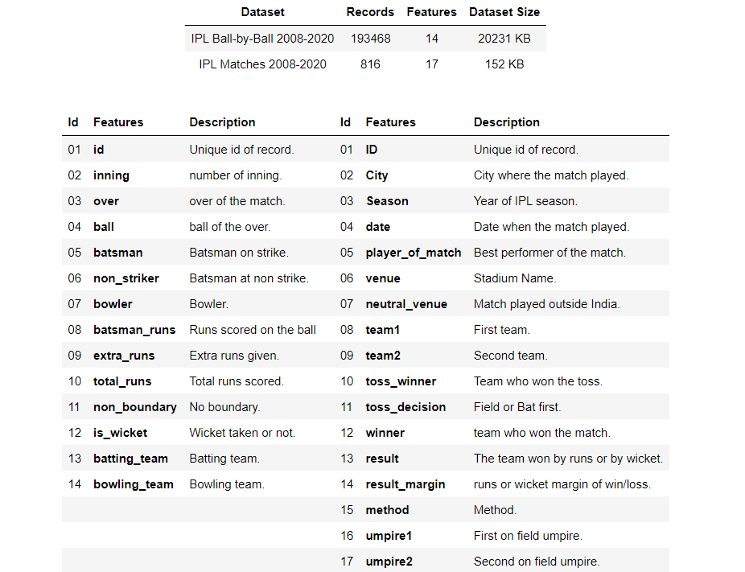
DATASET DETAILS

Slide 5
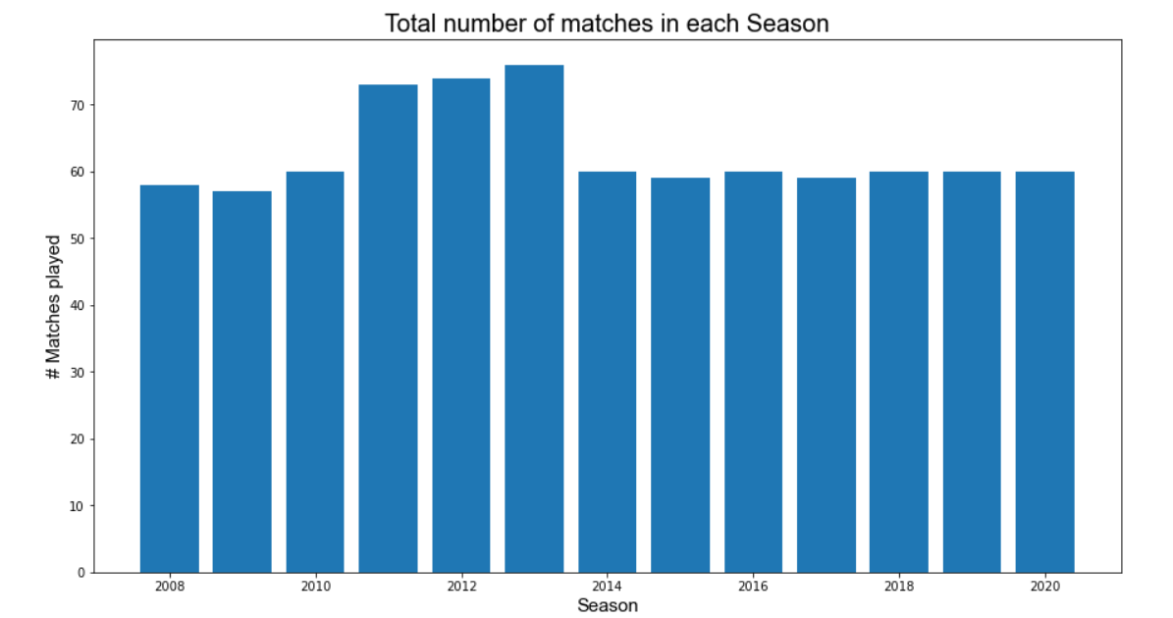
MATCH ANALYSIS
Observation: In season 2013 maximum number of matches played. The total number of matches played in 2013 is 76 followed by season 2012 (74) and 2011 (73).

Slide 6
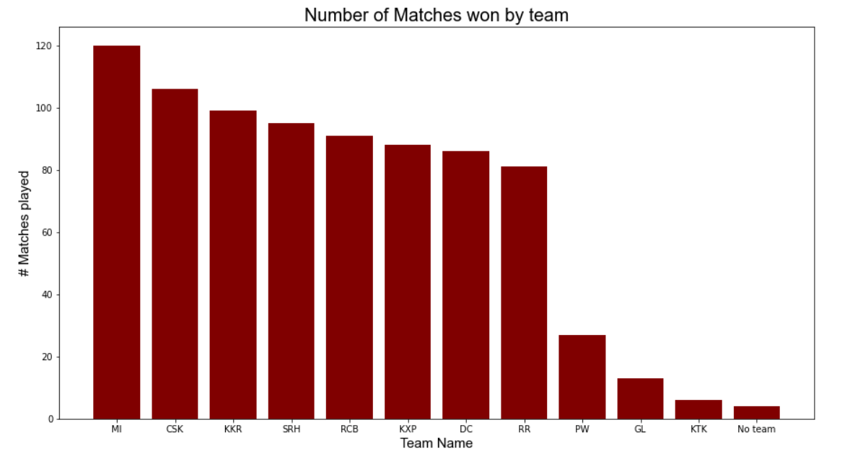
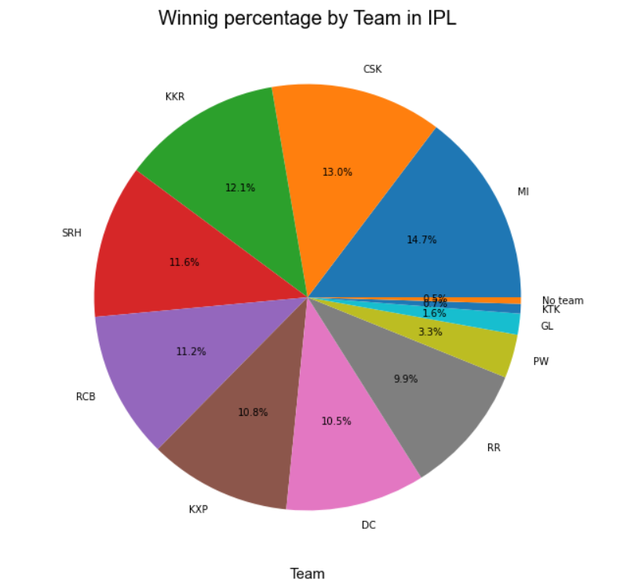
TEAM ANALYSIS
Observation:
MI won the maximum number of matches (120) followed by CSK (106) and KKR (99). We can say that MI is the most successful team in the IPL history.
MI has the highest winning percentage followed by CSK and KKR.
From 8 major IPL team, RR has the least number of wining matches.
Observation:
MI won the maximum number of matches (120) followed by CSK (106) and KKR (99). We can say that MI is the most successful team in the IPL history.
MI has the highest winning percentage followed by CSK and KKR.
From 8 major IPL team, RR has the least number of wining matches.

Slide 7
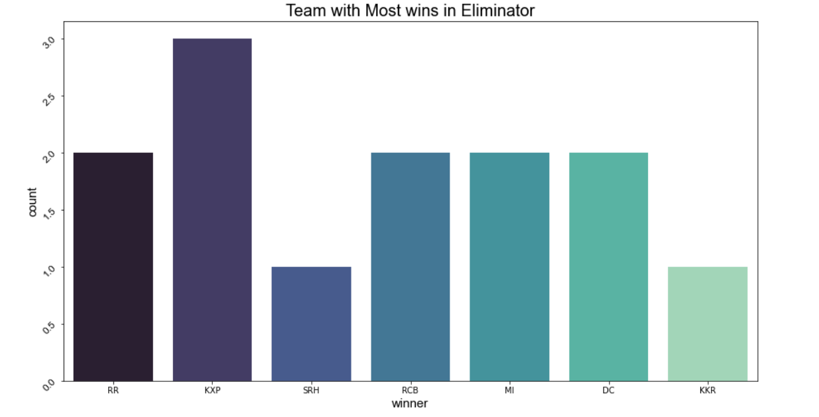
TEAM ANALYSIS
Observation:
KXP has the best record of winning in Eliminator matches.
SRH and KKR won just one match in Eliminator. (Eliminator are the knockout matches played before Final)

Slide 8
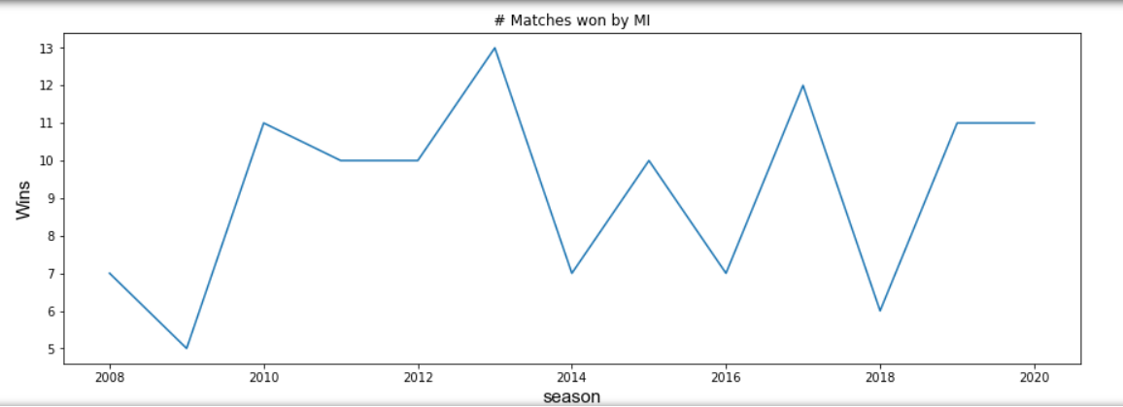
TEAM ANALYSIS
Observation:
2013 was the best year for MI. MI won 13 matches in that season.
2009 was the worst year for MI registered only 5 wins.

Slide 9
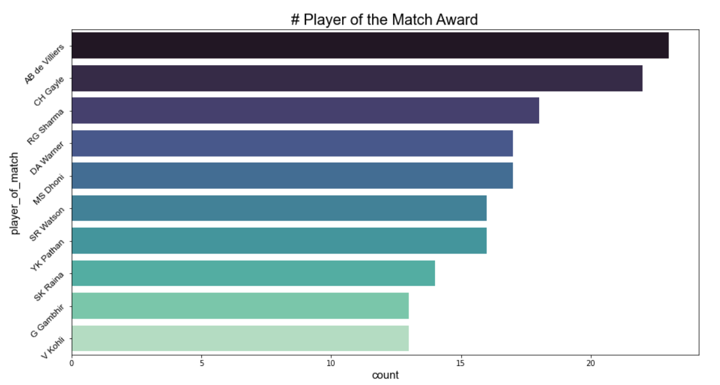
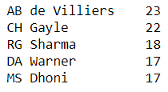
PLAYER ANALYSIS
Observation:
AB De Villiers is the most successful player in IPL for winning player of the match award 23 times followed by CH Gayle and RG Sharma.

Slide 10
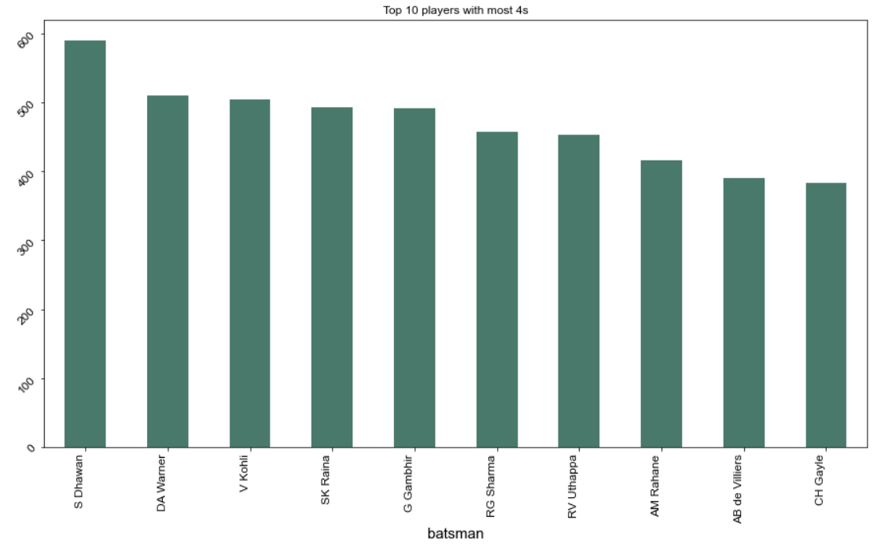
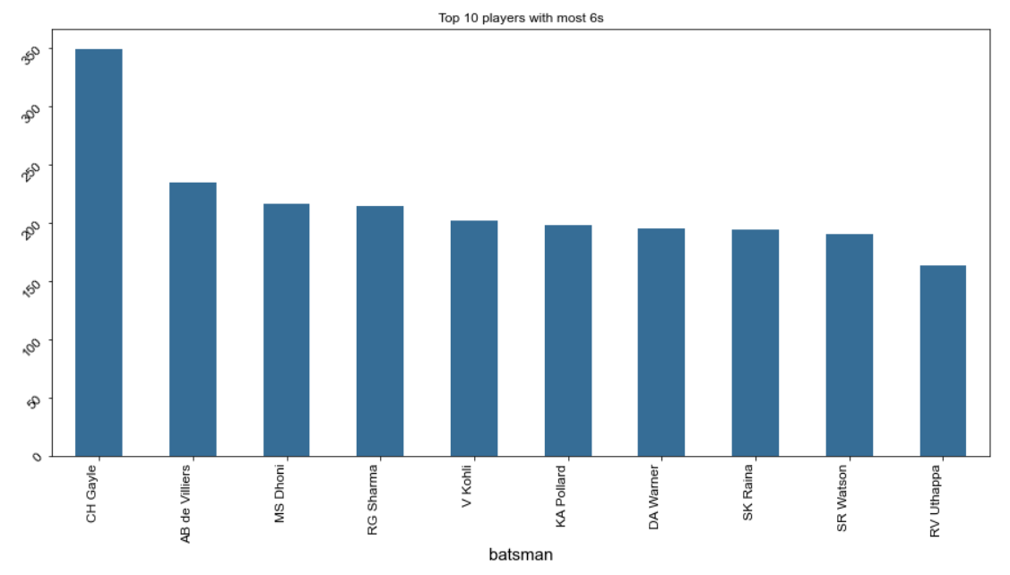
PLAYER ANALYSIS
Observation:
S Dhavan hit the highest number if 4s in IPL.
CH Gyle hit the highest number of 6s in IPL.
DA Warner, V Kohli, SK Raina, RG Sharma, RV Utthappa, AB De Villiers and CH Gayle can be said a power hitter batsman as they appear in top 10 list of both the number of 4s and 6s.

Slide 11
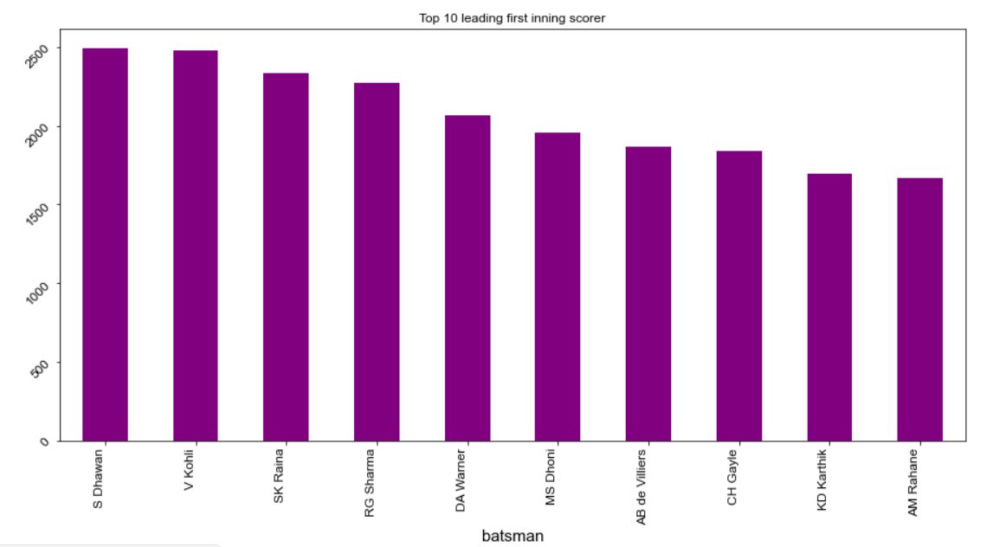
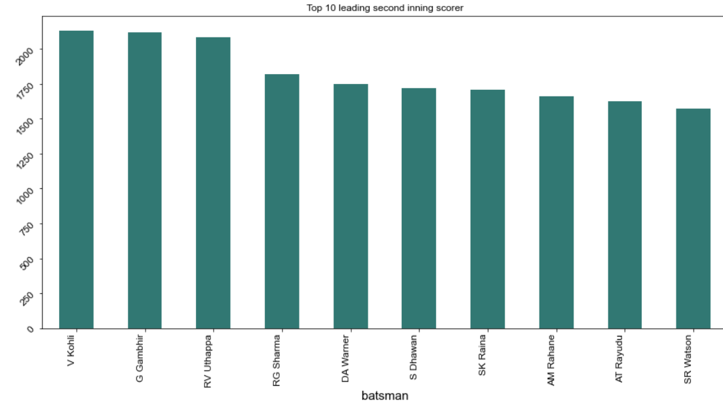
PLAYER ANALYSIS
Observation:
S Dhavan enjoys while batting first as he is the leading scorer when bat first.
V Kohli enjoys more while chasing the target score as he is the leading scorer when bat second.

Slide 12
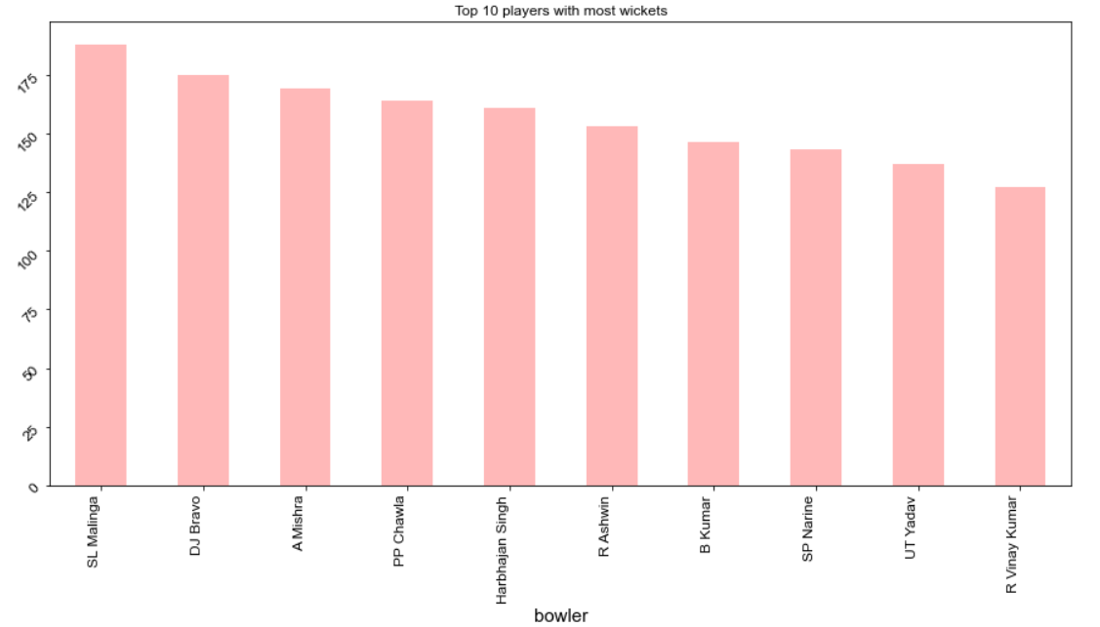
PLAYER ANALYSIS
Observation:
SL Malinga is the most successful wicket taking bowler followed by DJ Bravo and A Mishra.

Slide 13
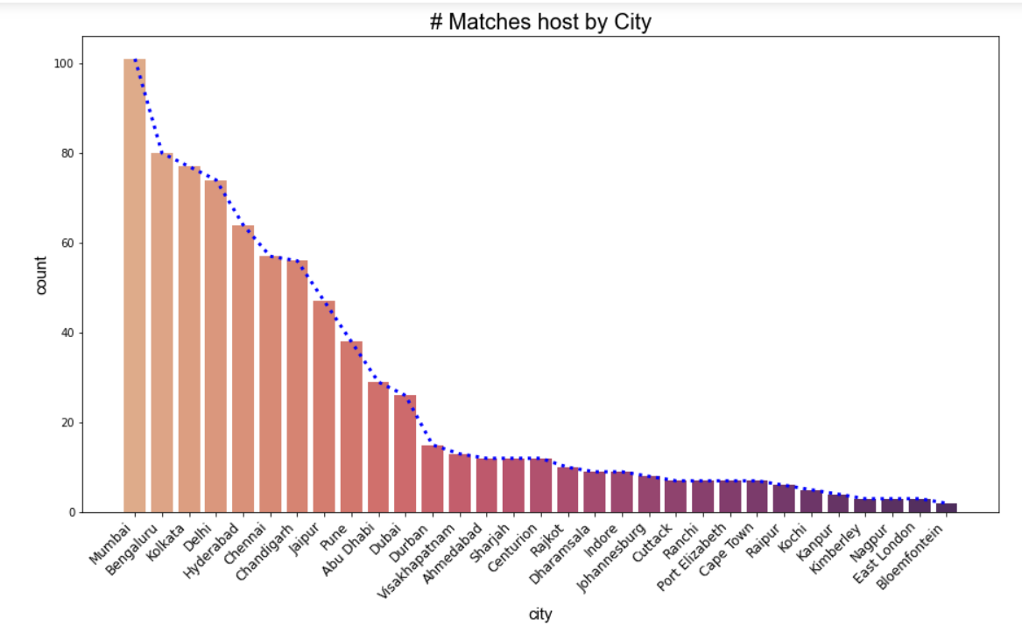
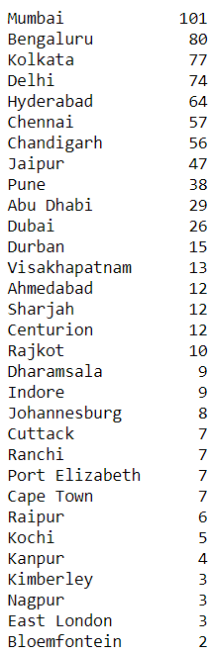
CITY ANALYSIS
Observation:
Mumbai host the most number of matches followed by Bengaluru and Kolkata.

Slide 14
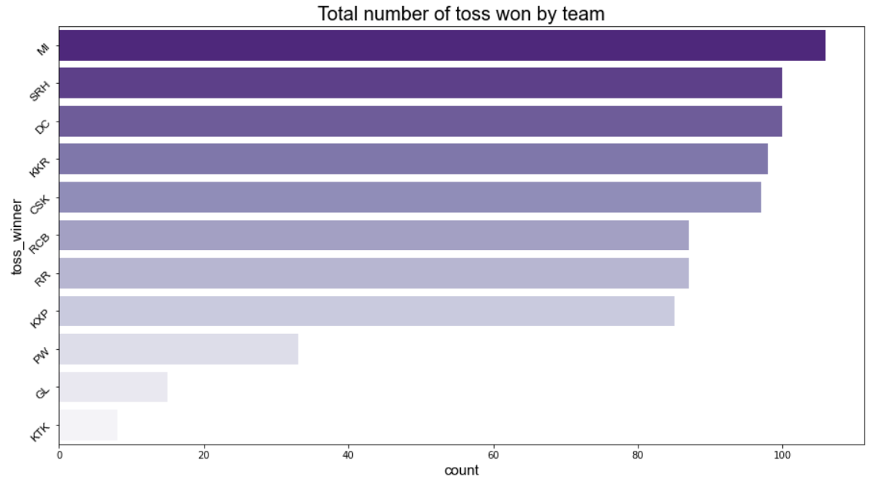
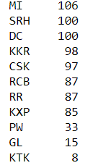
TOSS ANALYSIS
Observation:
MI won the most number of toss followed by SRH and DC.

Slide 15
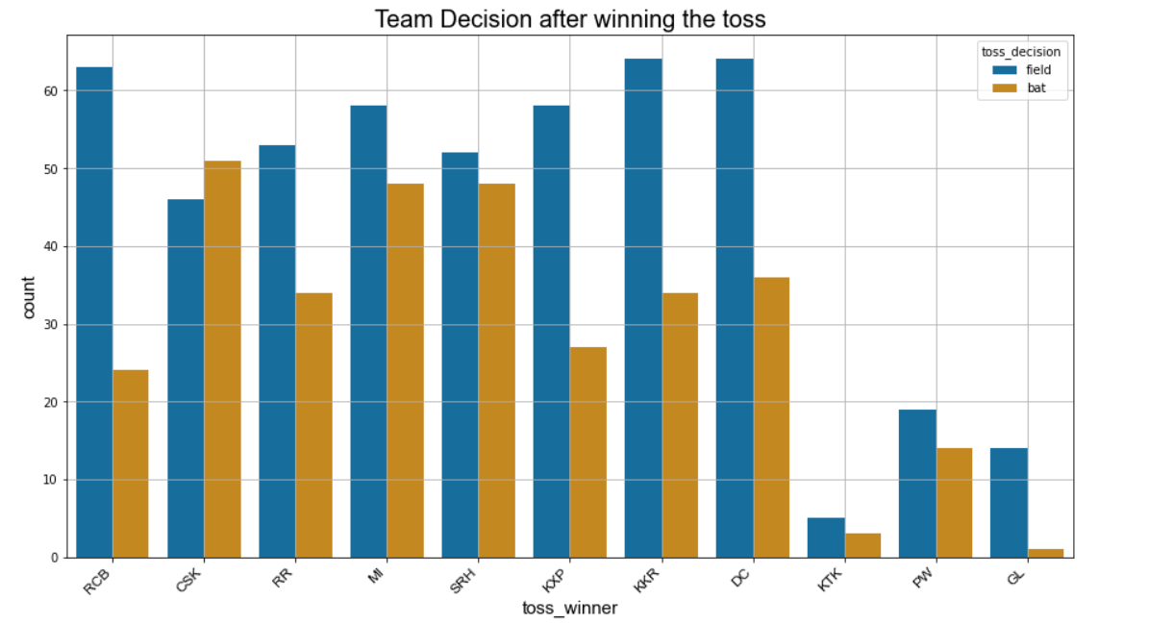
TOSS ANALYSIS
Observation:
Most of the team decided to field first after winning the toss. Only CSK bat first maximum time after winning the toss.

Slide 16
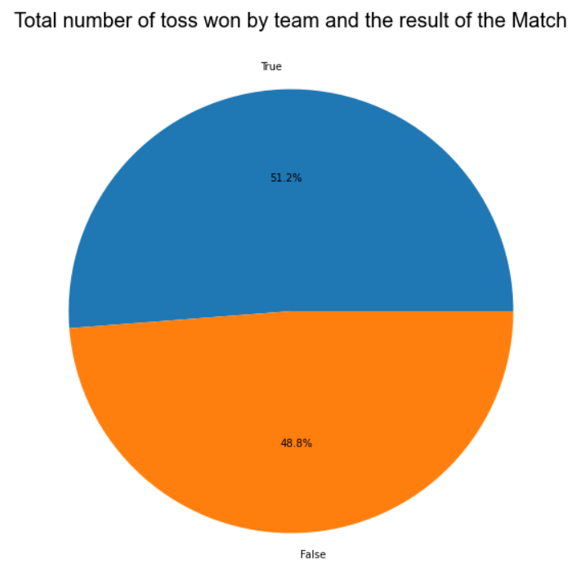
TOSS ANALYSIS
Observation:
Winning the toss has slightly edge of winning the match but it is not a huge impact on the winning

Slide 17
OBSERVATION
From the given data set the below observation can be drawn:
There are total 816 Matches played between 2008 and 2020.
MI won match by maximum run margin. MI won by 146 runs against DC in 2017 still holds a record.
In season 2013 maximum number of matches played. The total number of matches played in 2013 is 76 followed by season 2012 (74) and 2011 (73).
MI won the maximum number of matches (120) followed by CSK (106) and KKR (99). We can say that MI is the most successful team in the IPL history.
MI has highest winning percentage.
KXP is the most successful team if played in Eliminator.
MI is the most successful team in terms of season. It has 5 successful season where they won maximum number of matches in 2010, 2013, 2017, 2019 and 2020.
AB De Villiers has won the maximum number of player of the match title. He won 23 player of the match in IPL.
S Dhawan hit the highest number if 4s in IPL.
CH Gayle hit the highest number of 6s in IPL.
L Malinga is the leading wicket taker in IPL.
S Dhawan enjoys while batting first as he is the leading scorer when bat first.
V Kohli enjoys while chasing the target score as he is the leading scorer when bat second.
Mumbai host the maximum number of IPL matches. It host 101 matches in IPL.
MI is the most successful in winning the toss. MI won the toss 106 times highest by any team.
Most of the team decided to field first after winning the toss. Only CSK bat first maximum time after winning the toss.
Winning the toss has slightly edge of winning the match but it is not a huge impact on the winning the matches.

Slide 18
THANK YOU

